Slide 1



VEAL DASHBOARD_ final
View in Power BI
Last data refresh:
8/12/2023 5:36:32 PM UTC
Downloaded at:
8/12/2023 5:43:20 PM UTC

Slide 2
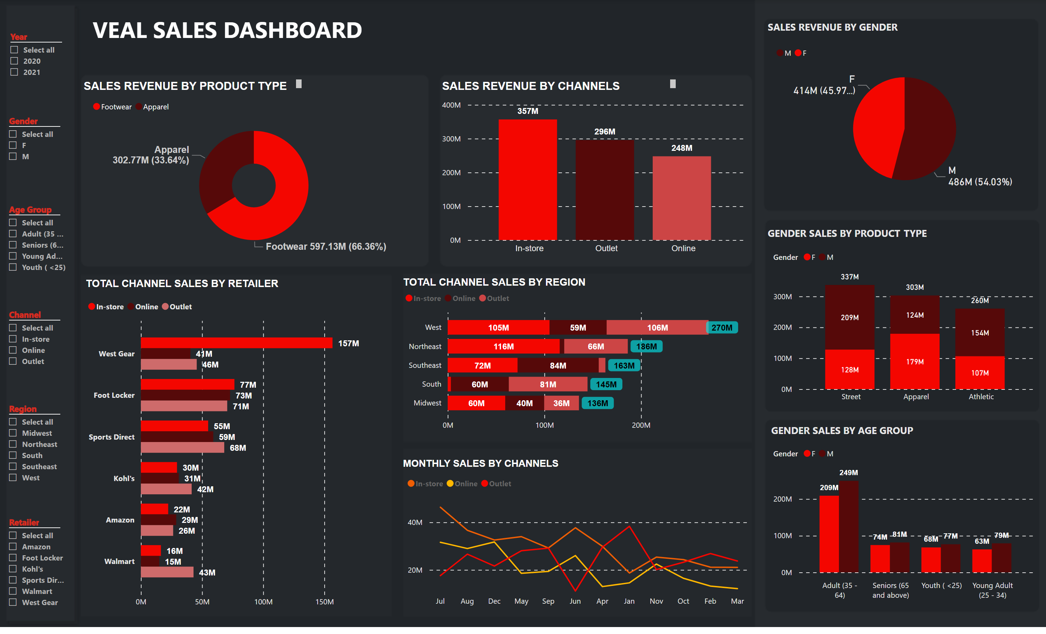
SUMMARY
Notes:
textbox
No alt text provided
textbox
No alt text provided
textbox
No alt text provided
textbox
No alt text provided
textbox
No alt text provided
textbox
No alt text provided
textbox
No alt text provided
textbox
No alt text provided
textbox
No alt text provided
donutChart
No alt text provided
clusteredBarChart
No alt text provided
lineChart
No alt text provided
barChart
No alt text provided
clusteredColumnChart
No alt text provided
clusteredColumnChart
No alt text provided
columnChart
No alt text provided
pieChart
No alt text provided
slicer
No alt text provided
slicer
No alt text provided
slicer
No alt text provided
slicer
No alt text provided
slicer
No alt text provided
slicer
No alt text provided

